Slide 1
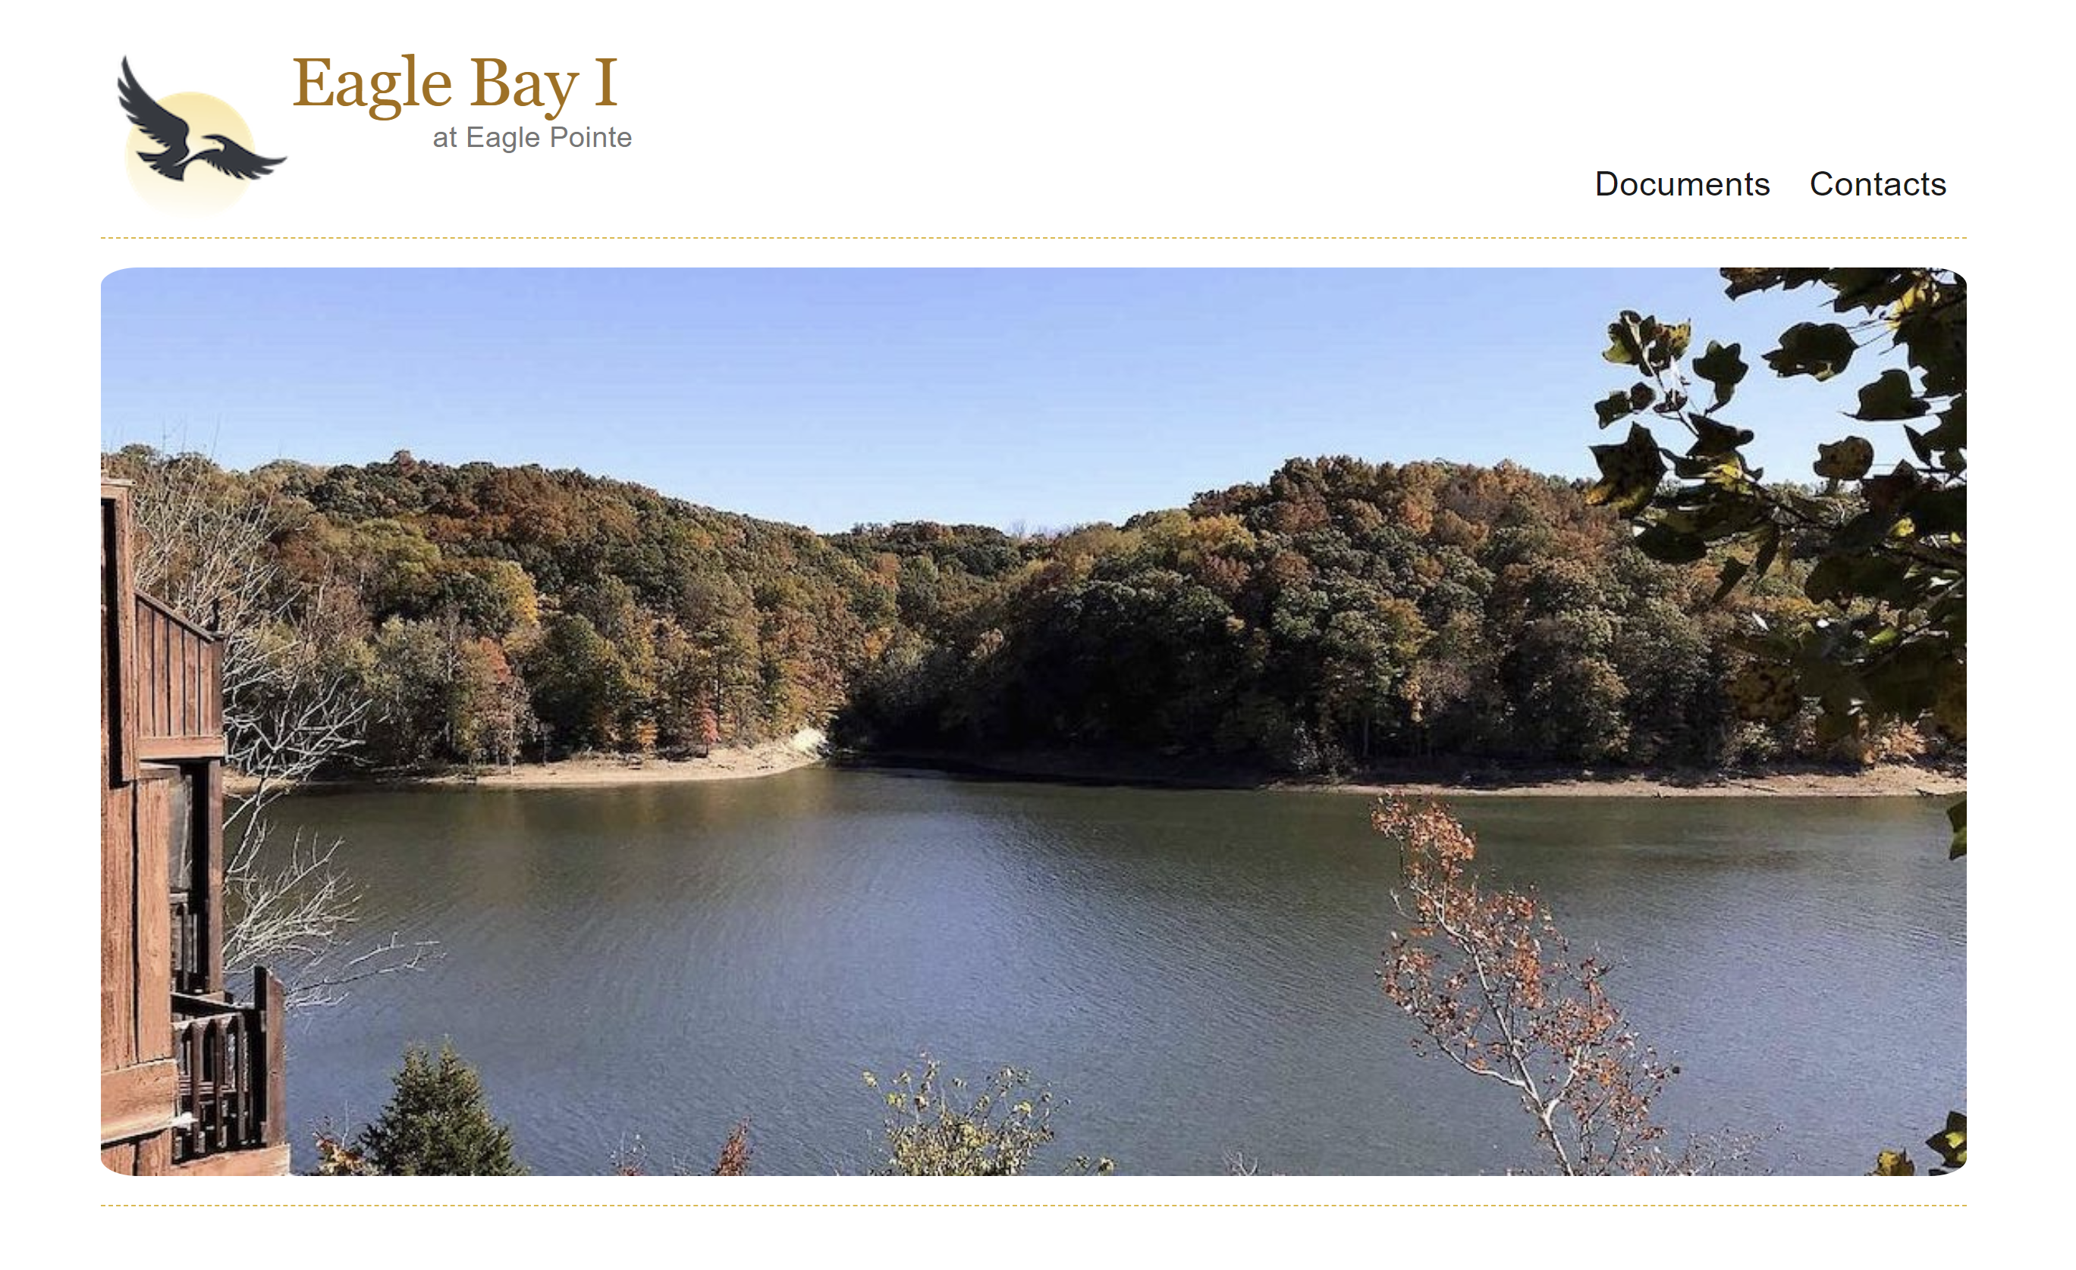

Slide 2
Introductions
Brian Earley – President
Aaron Stephen – Vice President
Alan Hogan – Treasurer
Bud Theissen – Secretary
Skip Pelton – At Large
Pegasus Properties – Property Manager
Homeowner Introductions (Name, Unit #, Years of ownership, occupation)

Slide 3
2020 Eagle Bay I Annual Meeting Minutes
Review the minutes
Motion to approve the minutes (please state your name)
Second to approve the motion (please state your name)
Vote to approve the minutes

Slide 4
President’s Report
The Board of Directors are here to serve the HOA
Transparent
Work within our budgetary constraints
Prioritize projects
Make decisions on the best interest of all ownership
Develop a ten year study

Slide 5
President’s Report
EAGLE BAY I TEN YEAR RESERVE STUDY
YEAR | STARTING BALANCE | RESERVE CONTRIBUTION | NEW ROOFS | PAINT | SEAL PAVEMENT | CHASEWAYS | GUTTER GUARDS | POOL | DECKS | ENDING BALANCE
2021 | 100,000 | 23,864 | 0 | 0 | 0 | 14,140 | 2,875 | 0 | 0 | 106,849
2022 | 106,849 | 29,500 | 0 | 0 | 25,000 | 7,283 | 0 | 0 | 0 | 104,066
2023 | 104,066 | 29,500 | 0 | 0 | 0 | 7,429 | 0 | 45,000 | 0 | 81,137
2024 | 81,137 | 29,500 | 0 | 75,000 | 0 | 7,577 | 0 | 0 | 0 | 28,060
2025 | 28,060 | 29,500 | 0 | 0 | 0 | 7,729 | 0 | 0 | 0 | 49,831
2026 | 49,831 | 29,500 | 0 | 0 | 0 | 7,883 | 0 | 0 | 0 | 71,448
2027 | 71,448 | 29,500 | 0 | 0 | 0 | 8,041 | 0 | 0 | 0 | 92,907
2028 | 92,907 | 29,500 | 0 | 0 | 0 | 0 | 0 | 0 | 25,000 | 97,407
2029 | 97,407 | 29,500 | 0 | 0 | 0 | 0 | 0 | 0 | 50,000 | 76,907
2030 | 76,907 | 29,500 | 0 | 0 | 0 | 0 | 0 | 0 | 50,000 | 56,407

Slide 6
President’s Report 2020 projects
Pool bottom drain replaced
1 Chase completed
Joint meeting with Eagle Bay I and Eagle Bay II
Reserved Parking Agreement implemented
Bicycle rack removed
Reviewed all contracts

Slide 7
President’s Report 2021
Tree removed at #52
Joint meeting with Eagle Bay I and Eagle Bay II
South building landing posts, joist hangers and handrails
North building lower level posts and joist hangers
Chaseways for units 38, 40, & 54
Quotes on new pool liner
Quotes on sealing pavement
Quarterly sprinkler inspection changed to Annual inspection

Slide 8
Treasurer’s Report
2020 Financials
Total Income $118,679
Total Expense $75,827
Income after Expense $42,852
Reserve Accumulation $20,000
Net Income $22,852

Slide 9
Treasurer’s Report
2021 Budget
Total Income $118,854
Total Expense $94,990
Income after Expense $23,864
Reserve Accumulation $23,864
Net Income $0

Slide 10
Treasurer’s Report
YTD Financials
Total Income $118,854
Total Expense $94,990
Income after Expense $23,864
Net Income $23,864

Slide 11
Treasurer’s Report
Delinquent Report
5 owners for $6,110.
Two accounts have liens against the property
New Collection Policy
Stage One: Any homeowner who is 15 days delinquent in paying the association dues and fees will be emailed from the Financial Agent reminding them of their financial responsibility.
Stage Two: A homeowner who is 30 days delinquent in paying the association dues and fees will be issued a “Late Notice” by the Financial Management Company and a fifty dollar ($50) late fee will be assessed with this billing.
Stage Three: Any homeowner who has not paid all dues and fees to a current status after 45 days will be issued a “Final Notice” by certified mail and be turned over to a collection attorney and will be subject to all collection fees, including a $250 administrative fee which will be assessed to cover the additional time and expense related to dealing with the delinquent account.
Should, for any reason, collection fails through Stage Three, then a mechanic’s lien will be placed upon the unit in the amount of the assessment for the entire year plus attorney fees and court costs. This action will be taken without further notice to the owner.
At the beginning of the year, any homeowner involved in court proceedings for past due amounts will automatically be turned over to the Attorney to file with the Court and the entire annual amount of dues will be accelerated.

Slide 12
PSA Update
2020 completed projects
Pool and cabana area opened with improvements
Water features reactivated
Golf course returned to excellent condition, hired new golf course superintendent, hired new golf professional, 1500 new member through MMC membership campaign
Clean up Clubhouse grounds, pool, boat storage areas.
Sahm’s took over food and beverage operation and catering

Slide 13
PSA Update
PSA Financials as of 12/31/2020
Total Income $659,803
General operating Expense $270,057
Total Capital Improvements $315,225
Net Income $74,521

Slide 14
PSA Update
2021 PSA Budget(from meeting minutes 1/23/21)
Total General Operating Exp. $243,553
Capital Improvements $499,113
Total Expenses $742,666
Total Income $742,666
New owner transfer fee increased to $500 paid by buyer at closing

Slide 15
PSA Update
2021 Projects
Capital projects - Irrigation system, Lease payments, Maintenance Shop (HVAC, Roofing)
Sahm’s smoker for catering, restaurant
Golf course equipment, Parking lot lights, Birdies walkway and front door, Boatyard storage cleanup, Deck overlooking pool, Dead tree removal
Gate system improvements
Approximate Total Funds Allocated $240,000

Slide 16
Election of Officers
President
Three year term
Candidates
Brian Earley

Slide 17
Questions and Comments

Slide 18
Adjourn
Please make a motion to adjourn the meeting (state your name).
Please second the motion (state your name).
Vote to Adjourn

